Slide 1
Smut fungus disease and host density in native, naturalized, and invasive populations of the grass Andropogon virginicus (broomsedge)
Janet A. Morrison Department of Biology The College of New Jersey

Slide 2
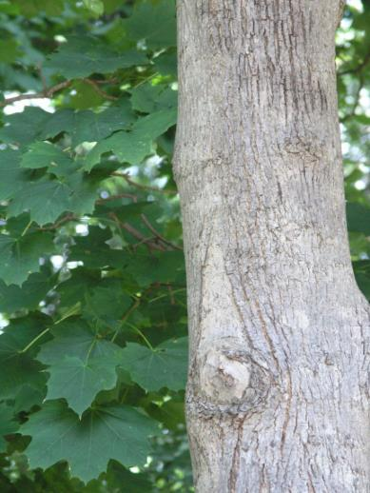
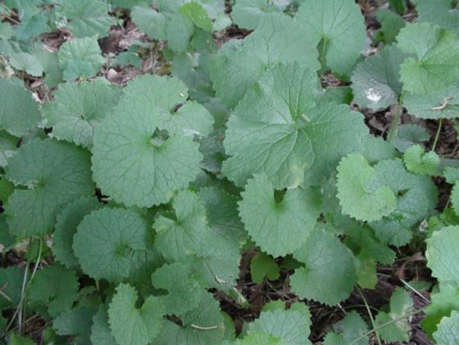
To become invasive, a non-native plant species needs
An appropriate environment. They typically establish in areas similar to the native environment :
Alliaria petiolata and Acer platanoides

Slide 3
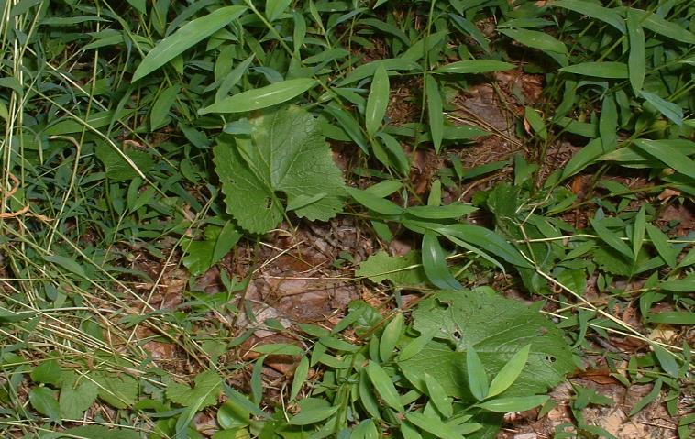
To become invasive, a non-native plant species needs
2. The ability to compete well against other community members (natives or other non-natives) (EICA).
Microstegium vimineum
Alliaria petiolata

Slide 4
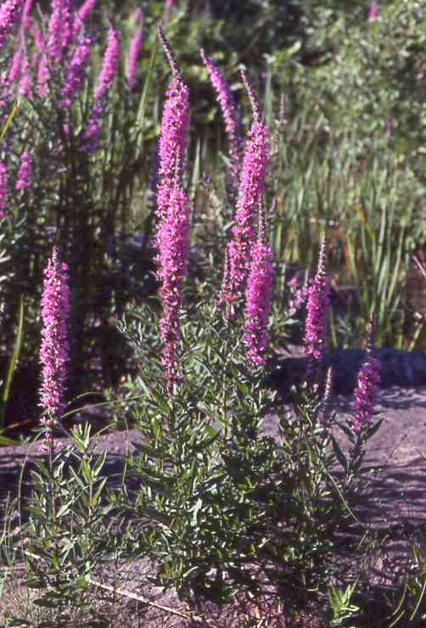
To become invasive, a non-native plant species needs
3. Escape from control by natural enemies (ERH).
Lythrum salicaria

Slide 5
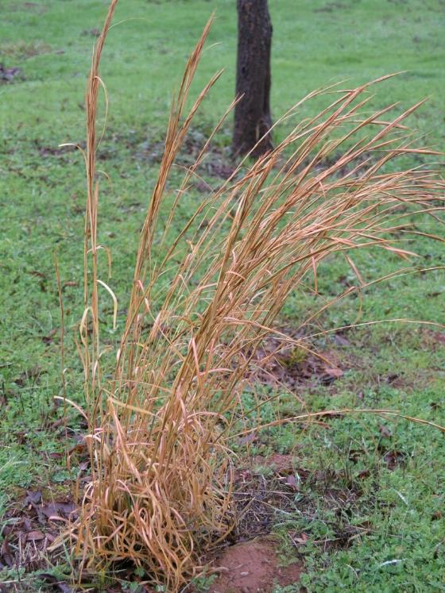
Andropogon virginicus (broomsedge) :
Native in the east
Naturalized in California
Invasive in Hawai’i
Do these populations differ in environmental suitability, competitive abililty, escape from disease?

Slide 6
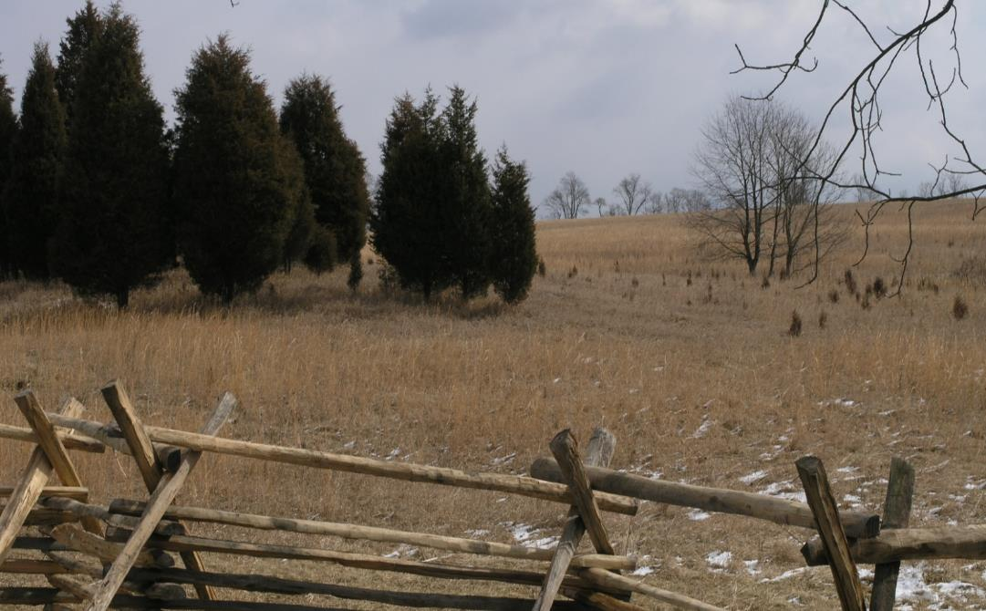
Native broomsedge old field successional C₄ grass common on low fertility, acidic soils a pasture weed

Slide 7
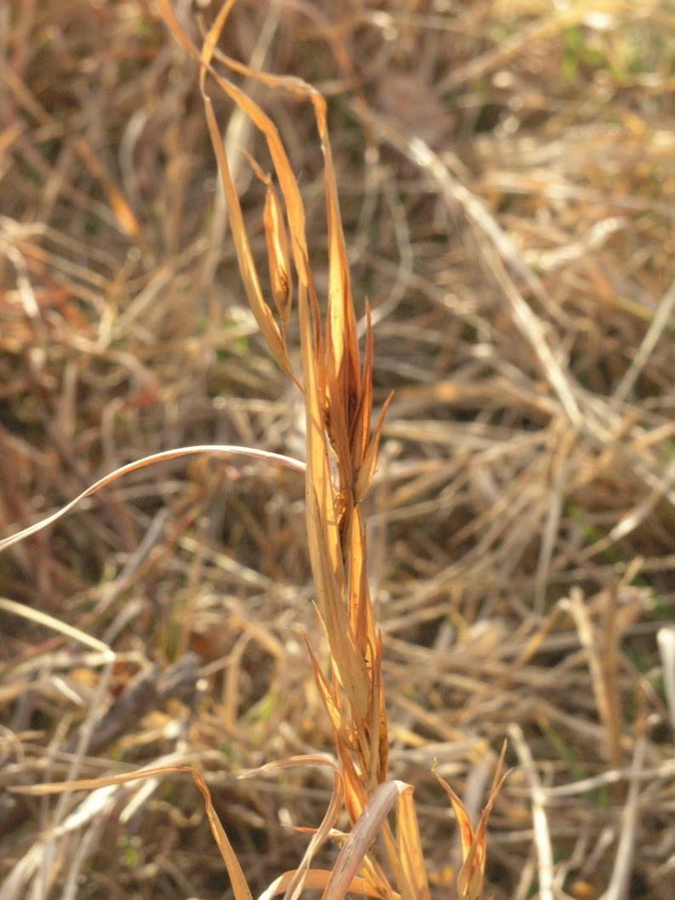
Infection by the plant pathogen Sporisorium ellisii, a smut fungus (Basidiomycetes)

Slide 8
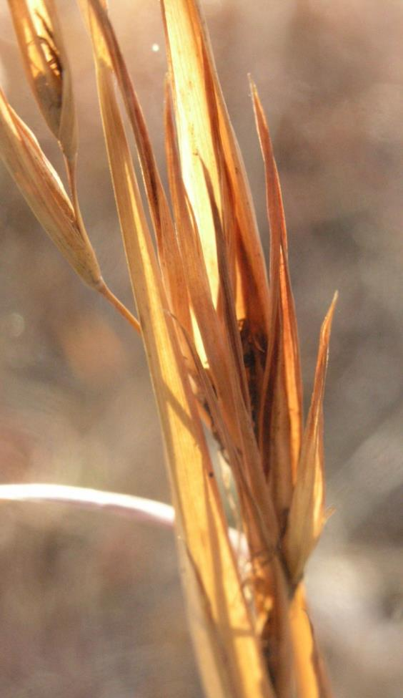
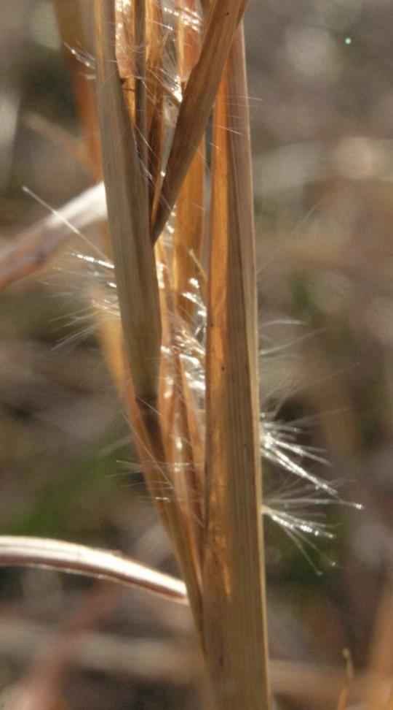
(see Bojdani, Graf et al poster)

Slide 9
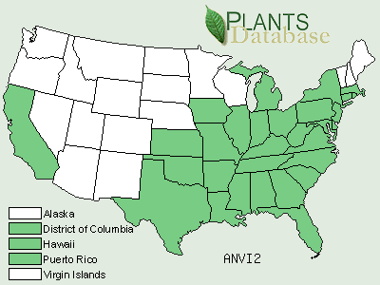
Distribution in the United States

Slide 10
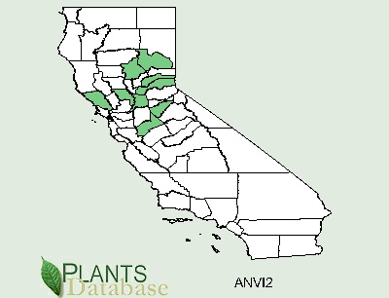
Naturalizing in California - no categorization as invasive in any source - restricted mostly to Central Valley counties

Slide 11
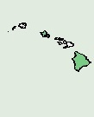
Invasive in Hawai’i HEAR – Hawai’ian Ecosystems at Risk Project http://www.hear.org/pier/species/andropogon_virginicus.htm
“Introduced and invasive” Hawai’i Maui Moloka’i Kaua’i Oah’u Lana’i
Also “invasive” in Australia, New Zealand, other Pacific islands

Slide 12
Population comparison across the three ranges :
1. Initial survey to locate populations (January – July 2005)
East - used maps to locate public lands (parks), university and college lands, and research stations - contacted agricultural extension agents for pasture sites
California - used on-line resources to focus the search: herbarium records, PLANTS database, Calflora - blanket emails to botanists etc. - maps for public lands

Slide 13
Population comparison across the three ranges :
1. Initial survey to locate populations (January – July 2005)
Hawai’i contacts with staff at Hawai’i Volcanoes National Park (HAVO), TNC, University of Hawai’i, U.S. Forest Service

Slide 14
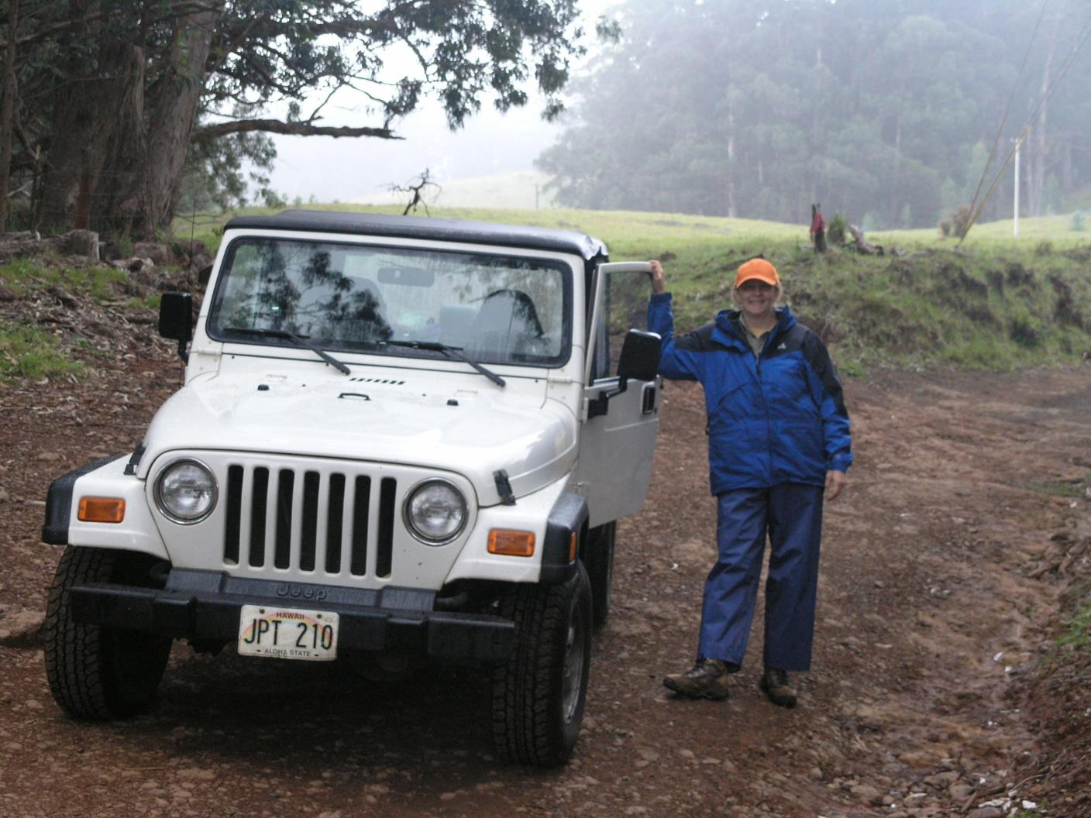

Slide 15
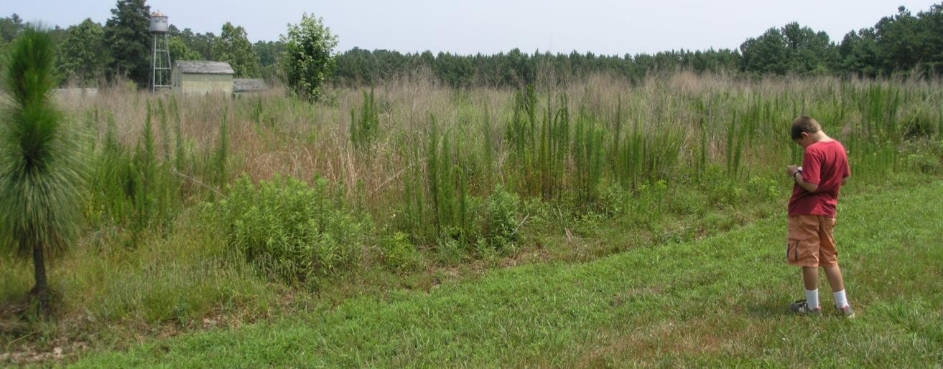
Population comparison across the three ranges :
1. Initial survey to locate populations (January – July 2005)
When a site was located – location by GPS, photograph with voice memo, no disease record.

Slide 16
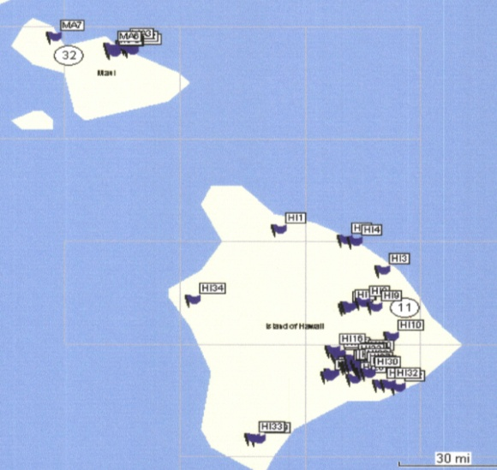
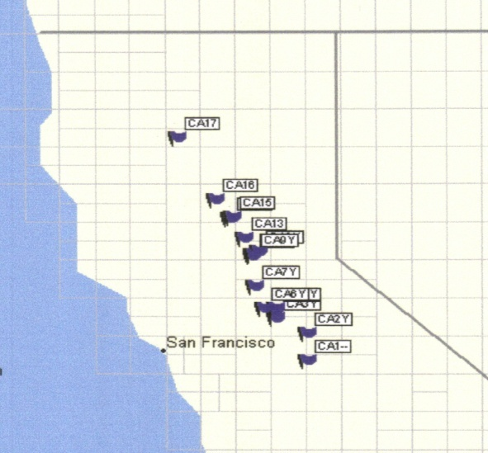
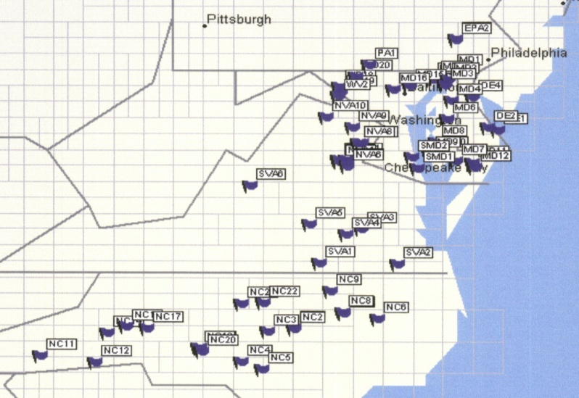
Population comparison across the three ranges :
1. Initial survey to locate populations (January – July 2005)
> 100 populations for possible inclusion

Slide 17
Population comparison across the three ranges :
2. Extensive permitting processing – 39 agreements, covering nearly all of the located populations and some new ones.
3. Second visits for collection of data and plant material.
(November 2005 – July 2006)
Re-visited each population for which permits were arranged, and some new ones.

Slide 18
0 m
100 m
FOCAL populations:
Number of plants on 100 meter long, 1 meter wide belt transects
10 transects when possible
FOCAL populations:
Number of plants on 100 meter long, 1 meter wide belt transects
10 transects when possible
visual observations for disease

Slide 19
0 m
100 m
NON-FOCAL populations:
2 transects, oriented at angles along longest axes

Slide 20
0 m
100 m

Slide 21
Eastern range:
Included 17 focal and 26 non-focal populations, from PA/NJ to northern SC
Wide range of locations :

Slide 22
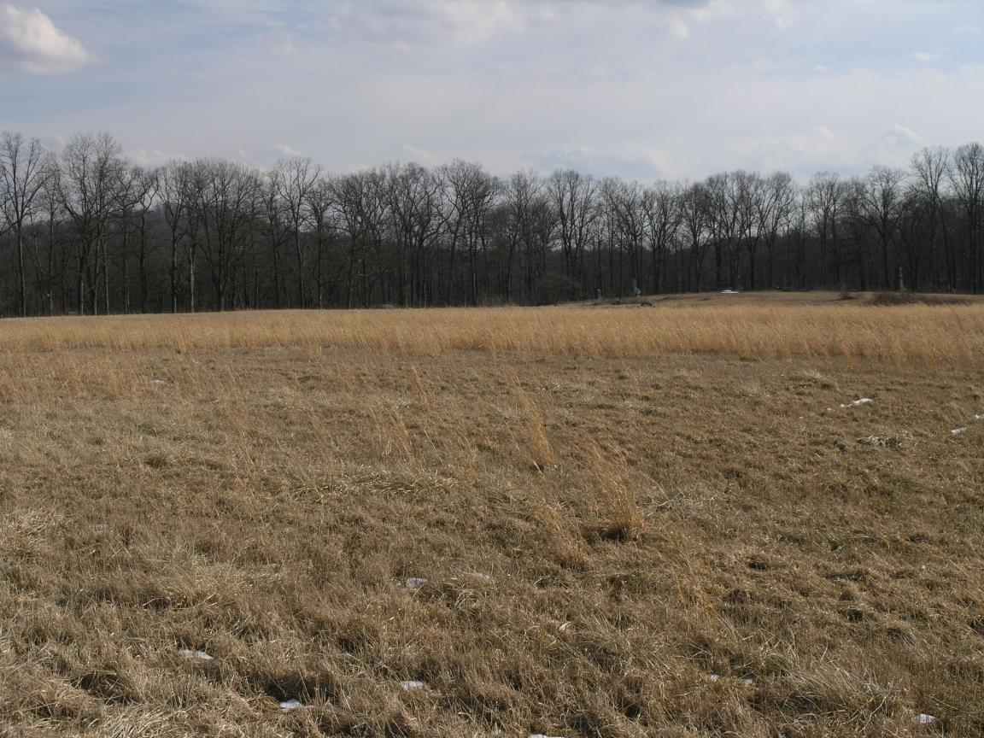
managed, open grasslands in parks (Gettysburg battlefield)

Slide 23
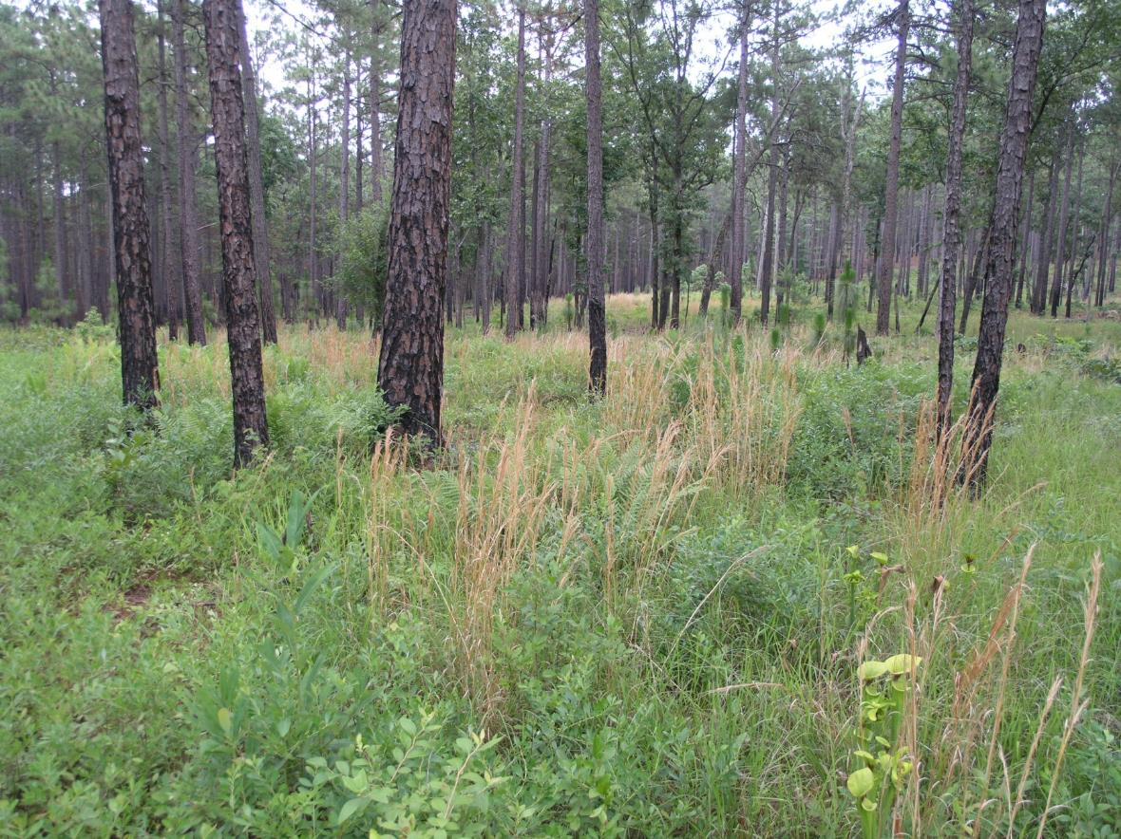
fire-maintained ecosystems (Sand Hills Nature Preserve, NC)

Slide 24
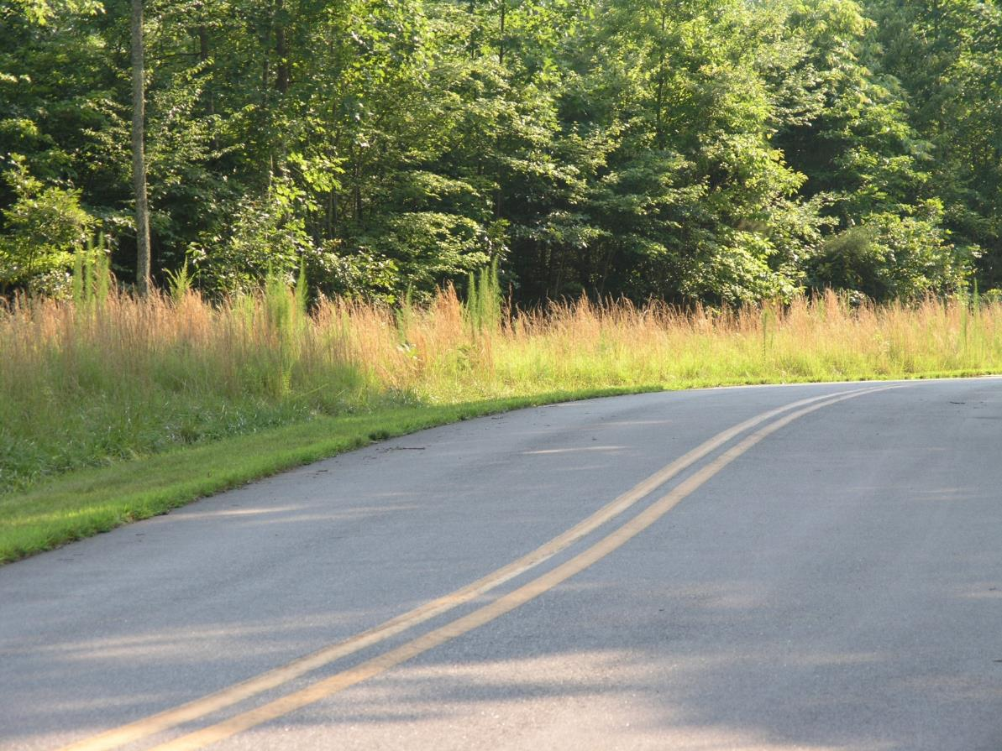
roadside populations

Slide 25
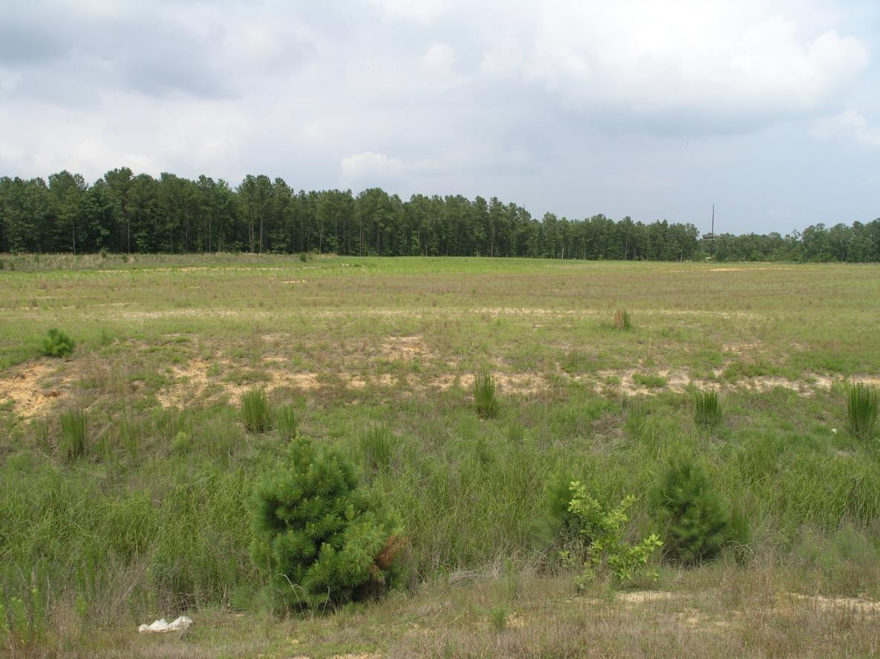
coastal plain – QVC property, NC

Slide 26
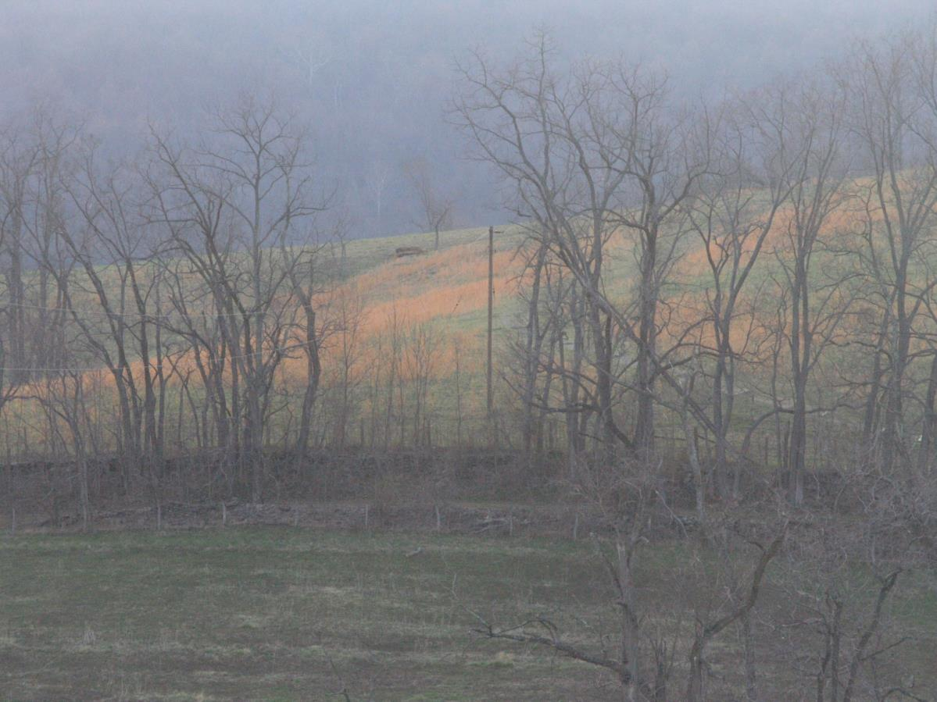
piedmont – Sky Meadows State Park, VA

Slide 27
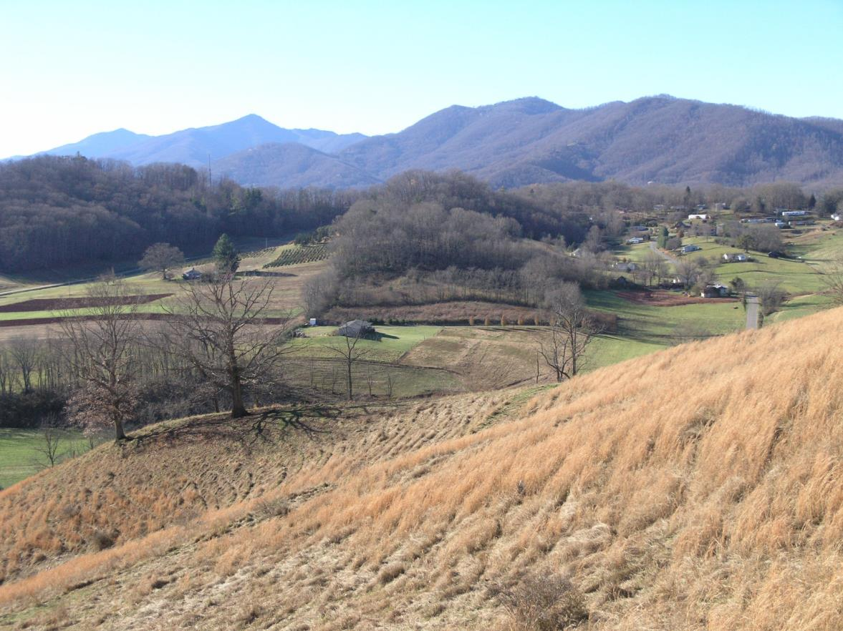
higher elevevation pasture – Mt. Research Station, NC (1500 m)

Slide 28
Californian range:
Included 4 focal and 4 non-focal populations
Restricted to water courses, shore lines (20-350 m elev.)

Slide 29
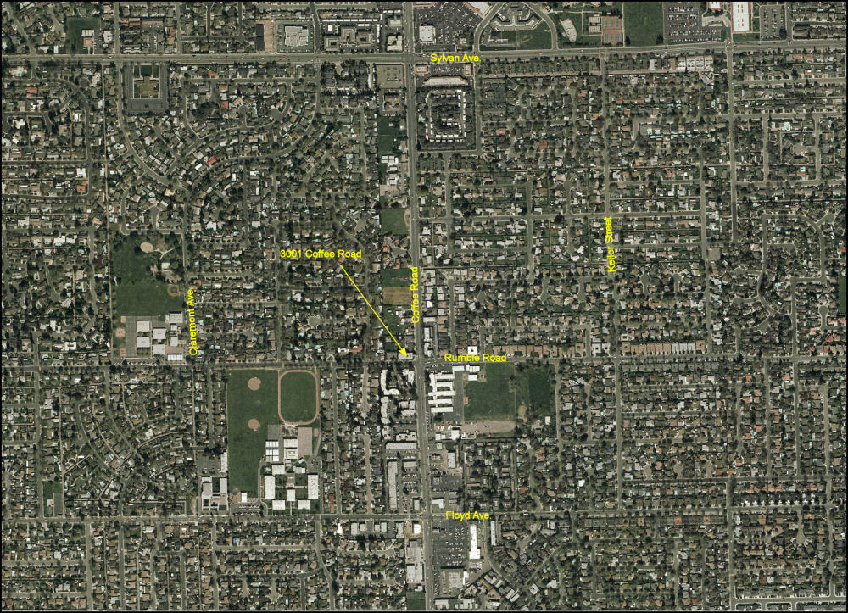
Many historical recorded stations in CA are no longer present (Modesto, CA)

Slide 30
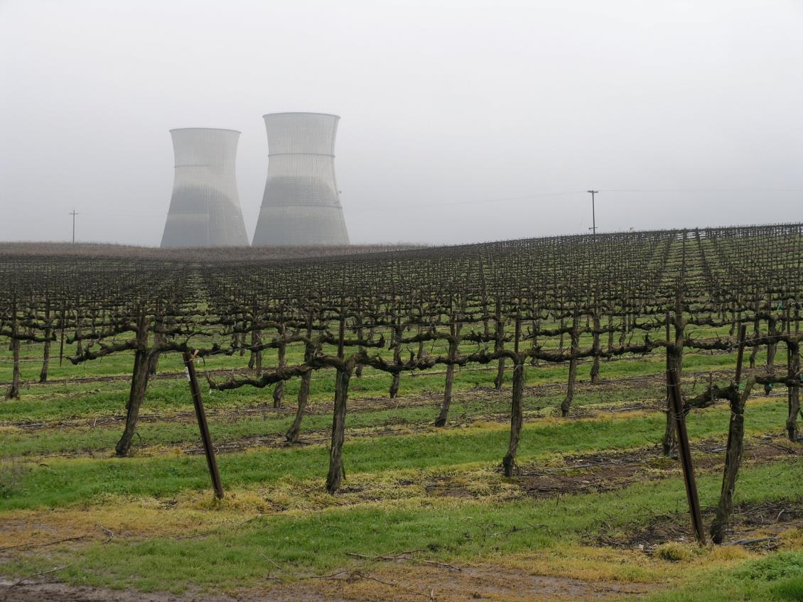
Rancho Seco, CA

Slide 31
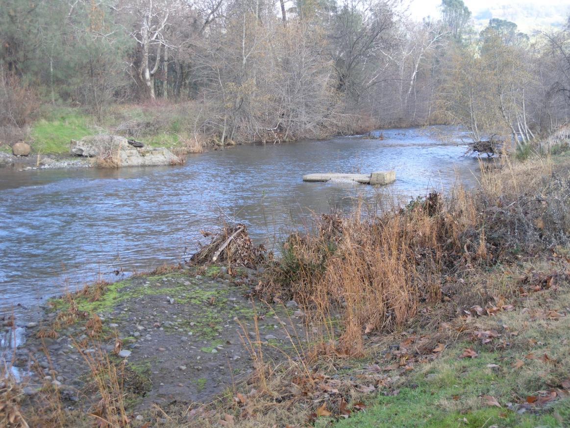
Chico, CA

Slide 32
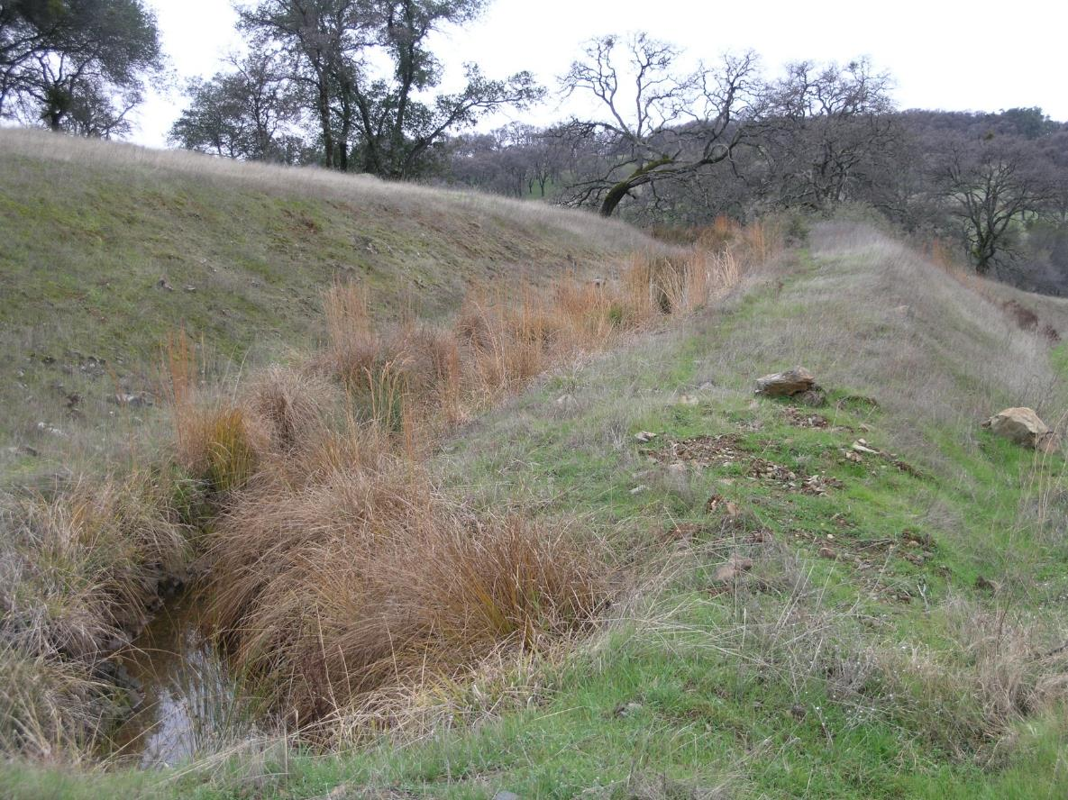
Grass Valley, CA

Slide 33
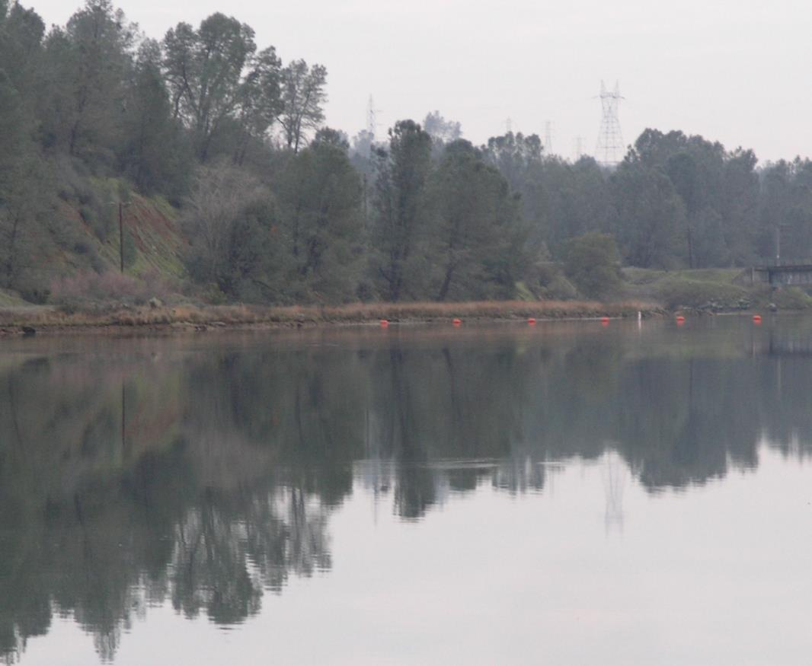
Oroville, CA

Slide 34
Hawai’ian range:
Included 8 focal and 8 non-focal populations, from The Big Island and Maui.
Found on nearly bare lava flows to older volcanic soils with organic matter.
Mostly 50 – 1200 m elev. ; up to 1940 m.
Windward side of islands.
Often remote ridges, crater walls – wind dispersed.

Slide 35
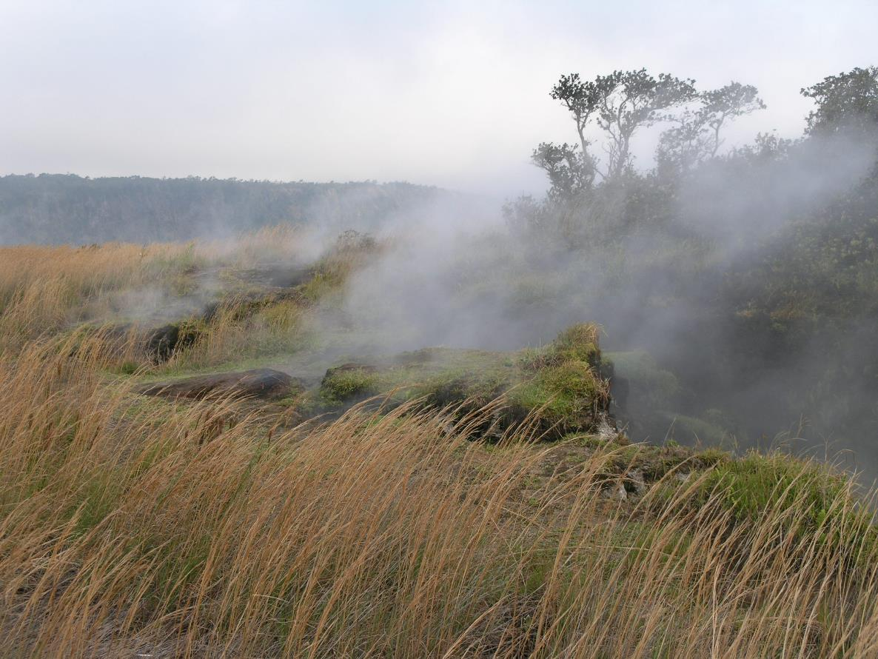
Hawaii Volcanoes National Park, the Steam Vents

Slide 36
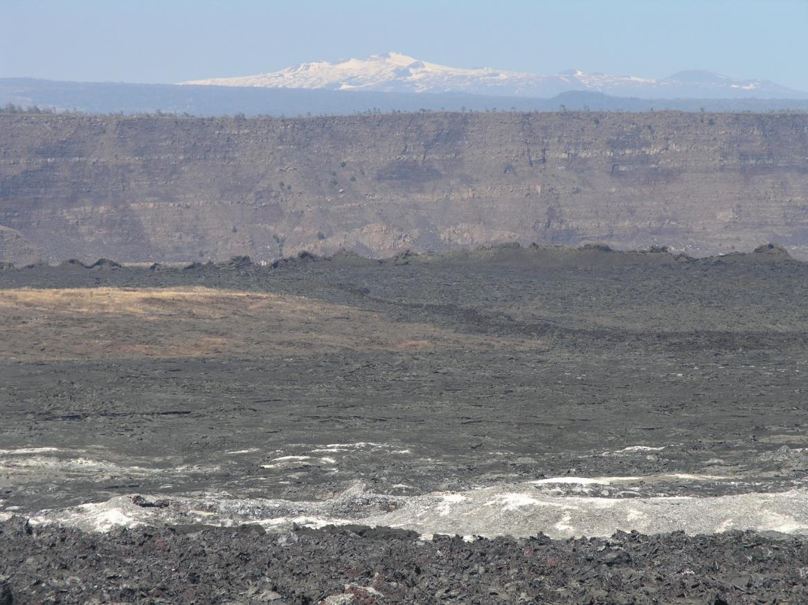
Hawaii Volcanoes National Park, crater rim

Slide 37
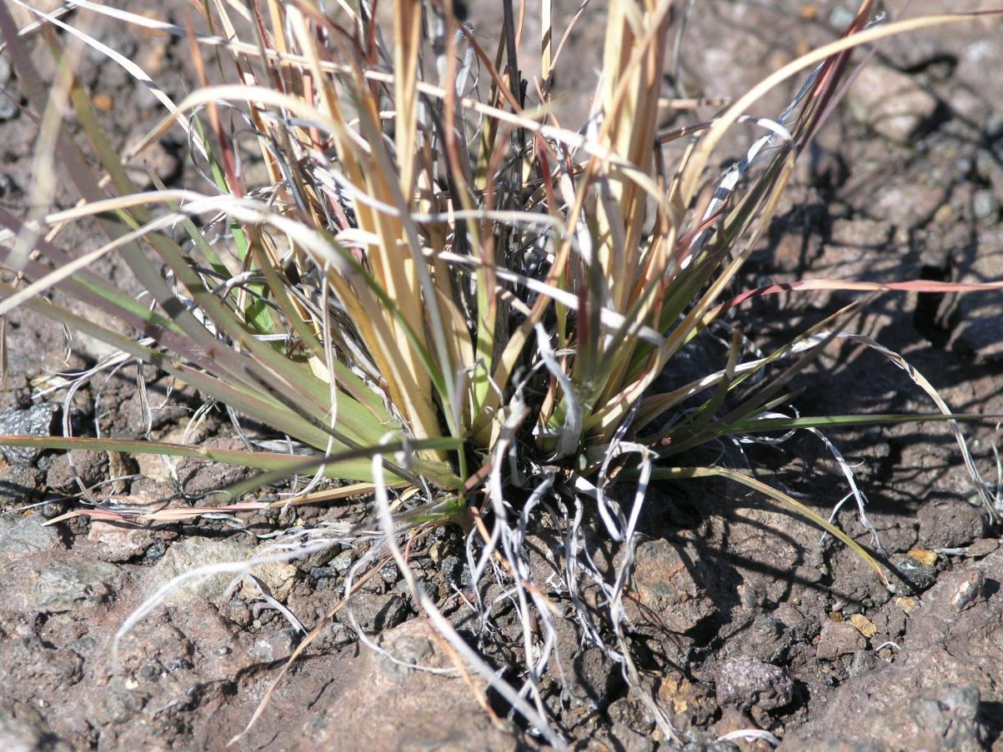
Hawaii Volcanoes National Park

Slide 38
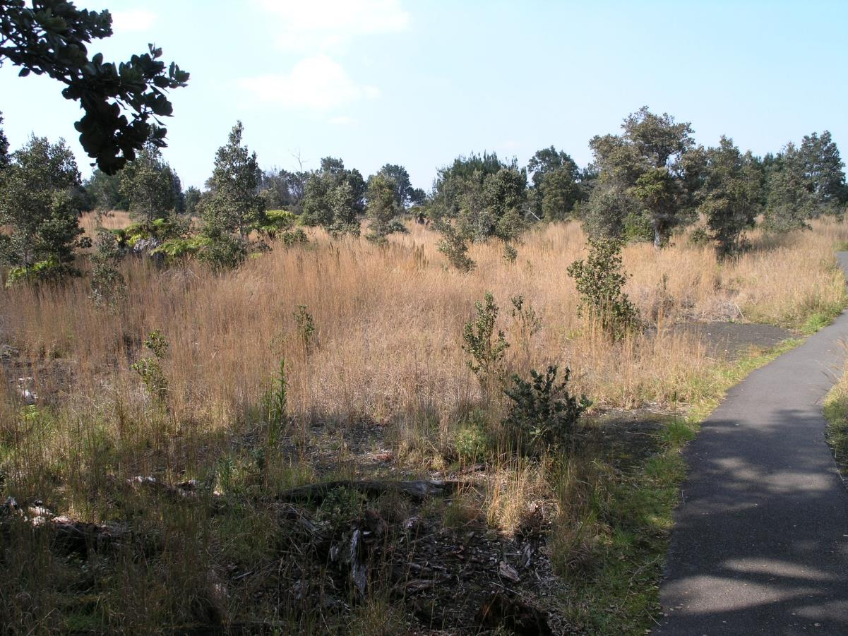
Hawaii Volcanoes National Park

Slide 39
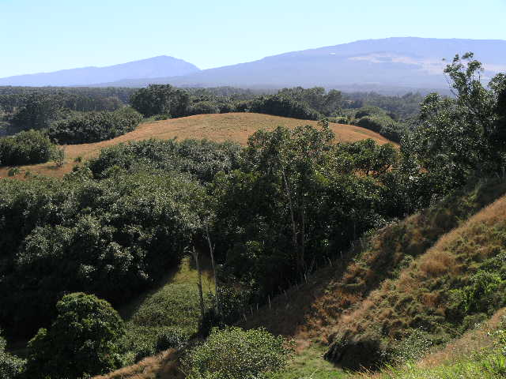
Maui

Slide 40
Plant density in the three regions (focal + nonfocal populations)
Means + 95% CL ; ANOVA: F = 0.09 ; df = 2,49 ; NS
(see Romanchuk and Decker poster)

Slide 41
Populations with smut fungus disease

Slide 42
Smut fungus disease in the three regions (focal + nonfocal populations)

Slide 43
Conclusions
1. Andropogon virginicus occupies a wide range of environments in its native range, and naturalized and invasive non-native ranges provide very different environments than the native range. Naturally tolerant or genetically variable - preadapted for spread into a wide range of environments.
.
2. Its competitive position in the community in the three ranges appears similar, in terms of plant density. What do we mean by “invasive?”
3. Non-native populations appear to have escaped the smut fungus disease. Potential for enemy release.

Slide 44
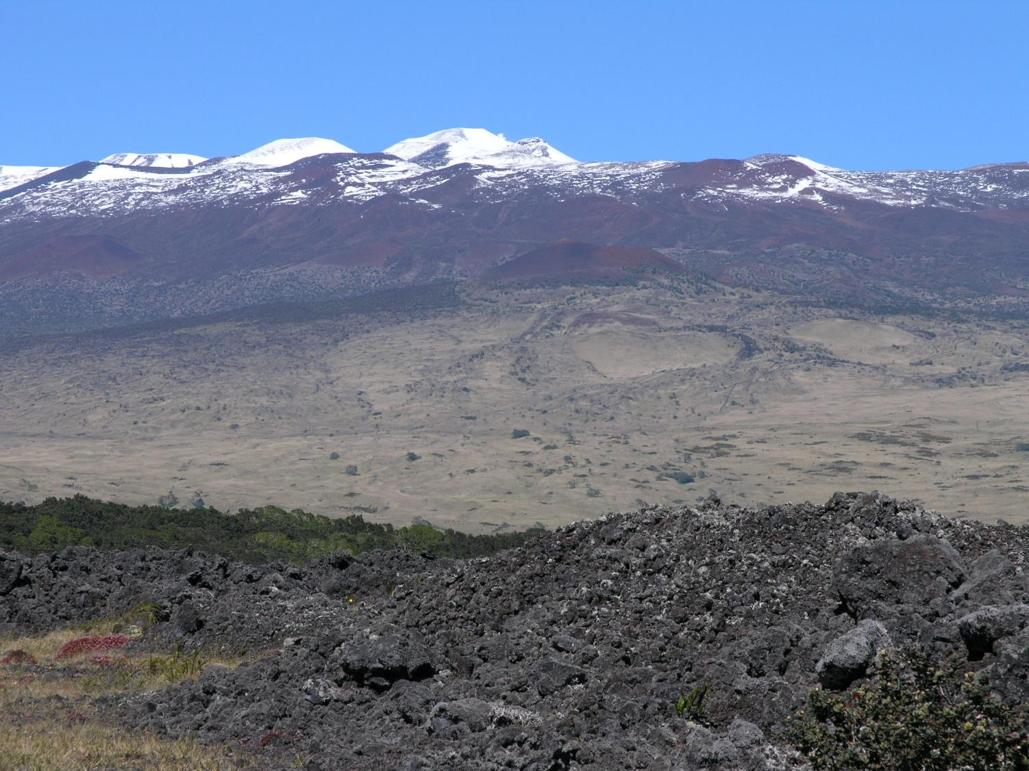
Acknowledgements USDA, TCNJ, Laura Melman, Scott Morrison Melman, and the many organizations that provided research permits.

